Slide 1


PROJECT
COURSE : Artificial Intelligence
PROJECT TYPE : Design and Implementation of an Intelligent Agent
GROUP MEMBERS : Viola Zeneli & Sidrit Rrustemi
Project Topic:
“Intelligent Employee Attrition Prediction Agent”

Slide 2


Project Overview
WORK DIVISION
This project develops an intelligent learning agent to predict employee attrition - whether an employee is likely to leave (Yes) or stay (No) - using HR-related data such as job role, satisfaction, income, and work experience. The study is based on the Employee Attrition & Retention Analytics Dataset from Kaggle, which contains real-world employee records commonly used for attrition analysis.
Employee Attrition and Retention Analytics Dataset, Kaggle:
https://www.kaggle.com/datasets/ajinkyachintawar/employee-attrition-and-retention-analytics-dataset
VIOLA ZENELI
Random Forest, Report & PPT Presentation
The main goal is to build a model that performs well under realistic conditions. In real HR data, far more employees stay than leave, resulting in a highly imbalanced dataset. Because of this, accuracy alone can be misleading. The project therefore emphasizes evaluation metrics such as the F1-score and applies techniques to reduce the impact of class imbalance in order to better identify employees who are likely to leave.
SIDRIT RRUSTEMI
XGBoost & Rest of Code, Streamlit Demo
GROUP WORK
Joint Review & Improvement of All Components

Slide 3
Problem Formulation – PEAS Framework
The employee attrition prediction problem is modeled as a task environment for an intelligent agent, where the agent observes employee-related information and produces attrition predictions that support human resource decision-making.
PEAS Component | Description
Performance Measure | The agent is evaluated using Accuracy, Precision, Recall, and F1-score. While accuracy reflects overall correctness, F1-score is prioritized, since failing to identify employees who leave is more costly than incorrectly flagging employees who stay.
Environment | The environment consists of a company’s human resources domain, represented by historical employee records with demographic, job, and satisfaction data.
Actuators | The agent outputs a binary attrition decision (Leave/Stay) and can modify its behavior through different decision thresholds to support various organizational strategies.
Sensors | The agent perceives the environment through employee features obtained from HR records, such as age, department, salary, job satisfaction, working years, and overtime status.

Slide 4
Model Selection
This project uses statistical learning models because employee attrition prediction involves complex, non-linear relationships between multiple employee attributes that cannot be captured using simple rules or heuristics. Among many possible models, we selected Random Forest (RF) and XGBoost due to their suitability for structured, imbalanced HR data and their strong empirical performance.
Random Forest (RF) | XGBoost
Ensemble approach: Combines multiple decision trees to reduce overfitting and improve generalization. Handles mixed features: Works well with both categorical and numerical employee data. Captures non-linear patterns: Models complex relationships between employee characteristics and attrition. More stable than a single tree: Less sensitive to noise and data variations. More expressive than linear models: Unlike Logistic Regression, it does not rely on strong linear assumptions. | Boosting approach: Iteratively improves performance by focusing on previously misclassified cases. Effective for imbalanced data: Prioritizes difficult samples, including minority-class employees. Regularization support: Controls model complexity and reduces overfitting. Stronger than Random Forest: Sequential learning often leads to higher predictive performance. Efficient and scalable: Learns efficiently on large, structured datasets.

Slide 5
Implementation
The intelligent agent was implemented as a structured machine learning pipeline.
Preprocessing included :
After preprocessing, Random Forest and XGBoost models were trained on the balanced training data. For each model, hyperparameter tuning was performed by evaluating various configurations to balance performance and computational cost. Model evaluation was conducted using accuracy, precision, recall, and F1-score, with emphasis on the attrition class.
The final model also supports adjustable decision thresholds, feature importance analysis.
The intelligent agent was demonstrated through an interactive Streamlit web application, deployed at: https://employeeattritionai.streamlit.app
Removal of Invalid Records
Target Variable Encoding
Categorical Feature Encoding
Feature Engineering
Train - Test Splitting
Numerical Feature Scaling
SMOTE-Tomek
Load Dataset

Slide 6
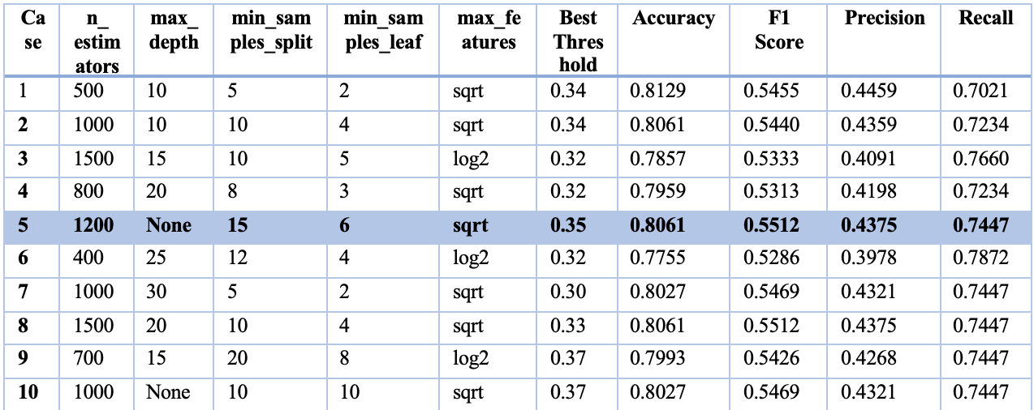
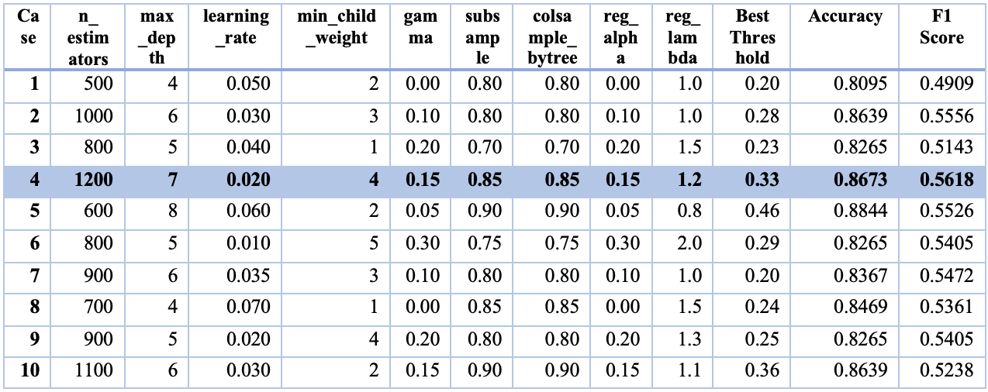
Hyperparameter Tuning
Many different hyperparameter configurations were tested at first, but only ten were chosen for evaluation, since trying all possible combinations would take too much time. Because the dataset is imbalanced, the final model was selected mainly based on the F1-score rather than accuracy.
Random Forest
XGBoost
Case 5 achieved the highest F1-score while maintaining strong recall and was therefore selected as the best Random Forest configuration for further comparison.
Case 4 achieved the highest F1-score while maintaining a balanced level of precision and recall and was therefore selected as the best XGBoost configuration for subsequent comparisons.

Slide 7
Evaluation & Results
Random Forest
XGBoost
Metric | Value
Accuracy | 0.8061
Precision (Attrition = 1) | 0.4375
Recall (Attrition = 1) | 0.7447
F1-Score (Attrition = 1) | 0.5512
Metric | Value
Accuracy | 0.8673
Precision (Attrition = 1) | 0.5952
Recall (Attrition = 1) | 0.5319
F1-Score (Attrition = 1) | 0.5618
<
The reported results are obtained using the best-performing configuration selected after hyperparameter tuning for each model.
Attrition = 1 represents employees who leave the company and is the minority and most important class to predict, as missing these cases can have a higher impact.
Because the dataset is imbalanced, accuracy alone can be misleading, since a model may appear accurate by mostly predicting employees who stay. For this reason, the comparison focuses on the F1-score, which combines precision and recall and better reflects performance on employees who leave.
While Random Forest achieves higher recall, XGBoost provides a better overall balance, achieving the highest F1-score. Therefore XGBoost was selected as the final model.

Slide 8
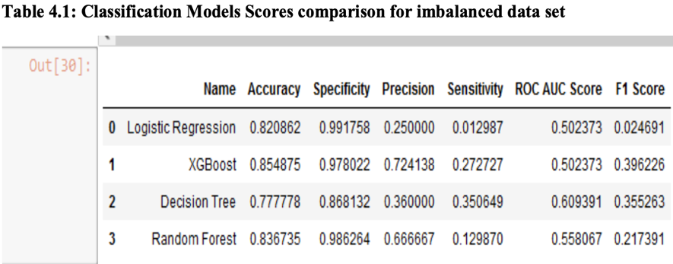
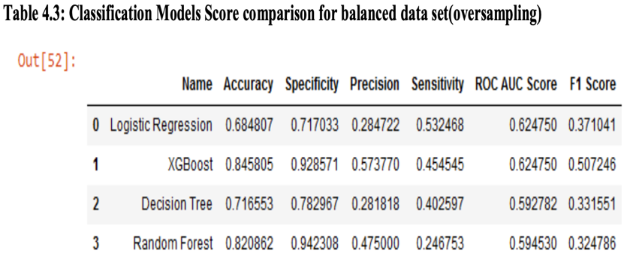
Comparison with Existing Research
Several studies have addressed employee attrition prediction using machine learning techniques. A relevant study is ¹“Employee Attrition Prediction Using Machine Learning Algorithms”.
In that study, Experiment 1 (Table 4.1) uses the original imbalanced dataset, where the best-performing model (XGBoost) achieves an F1-score of 0.396. In Experiment 2 (Table 4.3), the dataset is balanced using SMOTE, and the reported F1-score improves to 0.507.
In comparison, our XGBoost model achieves a higher F1-score (0.5618), both when compared to both experiments. For this dataset, our model shows strong performance, not only achieving higher F1-scores than the referenced study, but also considering that employee attrition is influenced by complex human behavior, which makes accurate prediction difficult.
¹ Employee Attrition Prediction Using Machine Learning Algorithms, ResearchGate, 2022. Available at: https://www.researchgate.net/publication/364322002_EMPLOYEE_ATTRITION_PREDICTION_USING_MACHINE_LEARNING_ALGORITHMS

Slide 9

Future Improvements
Better handling of imbalance:
Apply cost-sensitive learning to reduce critical errors when employees who leave are not detected.
Richer and larger datasets:
Using more data samples and additional employee-related features would improve model generalization and help better capture the complexity of human behaviour involved in attrition decisions.
Model enhancement:
Further hyperparameter tuning or combining multiple models could lead to improved predictive performance.
Real-world integration:
Integrate the agent into HR systems to allow continuous updates and practical use in real environments.
Ethical Considerations
Why this topic: Understand employee attrition to support fair retention strategies, not to penalize employees.
Intended use: Early awareness and positive actions (e.g., improving working conditions, satisfaction).
Human-centered design: The system is a decision-support tool, not an automated decision-maker.
Fairness: Final decisions remain with HR professionals.
Transparency & privacy: Feature importance supports explainability; employee data is assumed to be handled securely.

Slide 10

THANK YOU !
Live Demo: https://employeeattritionai.streamlit.app
Contacts:
vzeneli23@epoka.edu.al
srrustemi23@epoka.edu.al

